Slide 1
MGMT 6055 Project Scope & requirements
Lawrence Kinlin School of Business
Module 7
Notes:
Content for slides in this PPT file is drawn significantly from PMBOK, 6th edition, published by PMI (required text for this course)

Slide 2
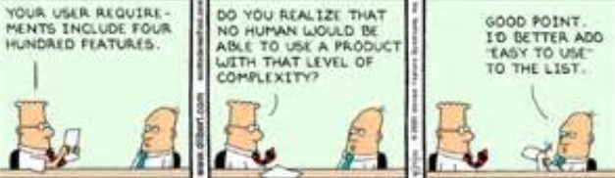
“Your user requirements include four hundred features”
“Do you realize that no human would be able to use a product with that level of complexity?”
“Good point. I’d better add “EASY TO USE” to the list”
Notes:
https://ca.images.search.yahoo.com/images/view;_ylt=Az_6xdadXEJWK2UADkg.7olQ;_ylu=X3oDMTIyOGV2czUyBHNlYwNzcgRzbGsDaW1nBG9pZAMwZjQ3YTgxMjc1NTk1NDE4OGU2ZjQ2ZjNlYmE4MTUxZgRncG9zAzgEaXQDYmluZw--?.origin=&back=https%3A%2F%2Fca.images.search.yahoo.com%2Fyhs%2Fsearch%3Fp%3Ddilbert%2Bproject%2Brequirements%26type%3Drogers_hispeed%26fr%3Dyhs-rogers-rogers_001%26fr2%3Dpiv-web%26hsimp%3Dyhs-rogers_001%26hspart%3Drogers%26tab%3Dorganic%26ri%3D8&w=640&h=189&imgurl=assets04.blog.usabilla.com%2Fwp-content%2Fuploads%2Fuser-exp-3-1.gif&rurl=http%3A%2F%2Fblog.usabilla.com%2F10-best-ux-infographics%2F&size=31.4KB&name=10+of+the+Best+UX+Infographics+-+The+Usabilla+Blog&p=dilbert+project+requirements&oid=0f47a812755954188e6f46f3eba8151f&fr2=piv-web&fr=yhs-rogers-rogers_001&tt=10+of+the+Best+UX+Infographics+-+The+Usabilla+Blog&b=0&ni=21&no=8&ts=&tab=organic&sigr=11hcco34j&sigb=15p8kcj96&sigi=11upoug9l&sigt=11i6qejc1&sign=11i6qejc1&.crumb=pnISuN5PHIW&fr=yhs-rogers-rogers_001&fr2=piv-web&hsimp=yhs-rogers_001&hspart=rogers&type=rogers_hispeed

Slide 3

Learning Objectives
Collect Requirements - Outputs
Define Scope process

Slide 4
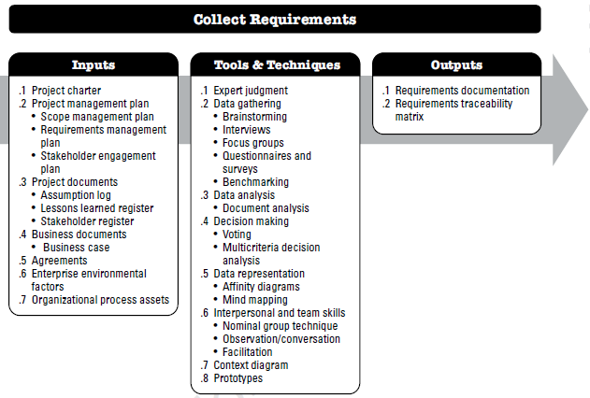
Recall from last few modules (PMBOK 6th ed., p. 138)…
Notes:
Source: PMBOK 6th ed. (PMI)

Slide 5
Output #1: requirements documentation (Business Requirements Document - BRD)
Details the business solution (customer needs)
Gain agreement with stakeholders
Used for communication and understanding
Example (modify to suit your project type)
Reminder: To access embedded templates, switch to slide editor mode (not slideshow mode) and double click on template icon!

Slide 6
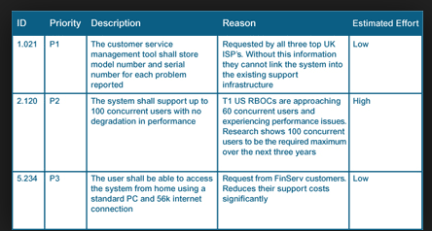
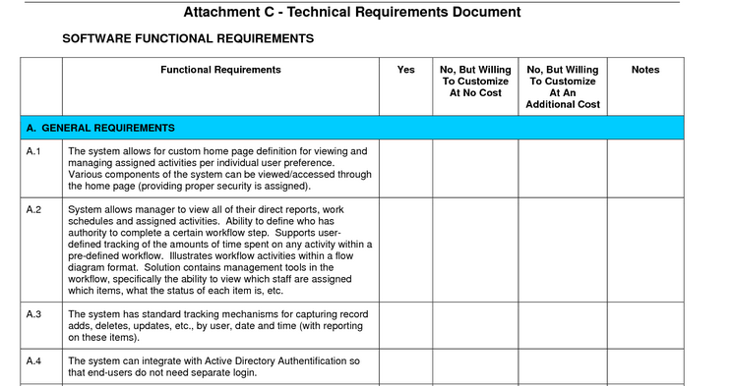
Business Requirement Document - Examples

Slide 7
Output #1: Business Requirements Document (BRD)
Documenting functional and non-functional requirements…
https://www.youtube.com/watch?v=D6R7njeK-qg (functional)
https://www.youtube.com/watch?v=2DwpAyzJrVQ (non-functional)
Pay attention to how requirements are worded in the videos! For example:
Requirements are brief, clear and concise statements with verbs like “shall” and “will” (not “should”)
Requirements aren’t written as activities
Requirements must be measurable and clear (especially when writing quantities – no ambiguity like “some” or “a few”)
Don’t combine multiple requirements into one requirements statement

Slide 8
Output #2: Requirements Traceability Matrix
Table used to link requirements to their origin and traces them throughout the project lifecycle
Ensures requirements add business value by linking to business/project objective
Ensures requirements are completed
Example (modify to suit your project type)

Slide 9

Defining the Project Scope
Notes:
Image: https://www.google.ca/url?sa=i&rct=j&q=&esrc=s&source=images&cd=&cad=rja&uact=8&ved=2ahUKEwjLsMzbuf3dAhXM7IMKHUnSCUcQjRx6BAgBEAU&url=http%3A%2F%2Fmjachdesigns.com%2Fportfolio-item%2Fproject-scope%2F&psig=AOvVaw3evN7zuL5-fb5Bm9TJlDvL&ust=1539315049050556

Slide 10
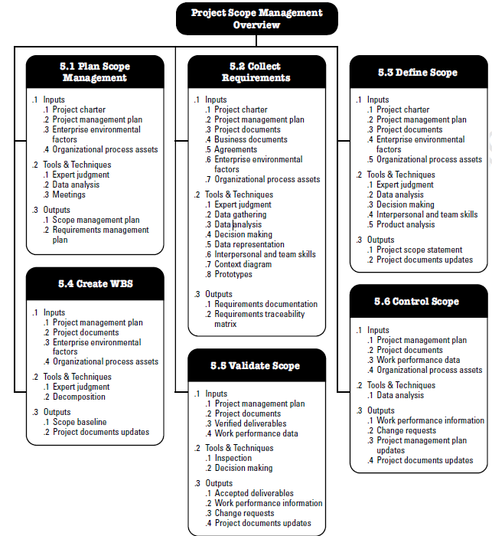
SIX scope-related processes (activities) are described in the PMBOK 6th ed. text
Source: PMBOK (6th ed), pg. 130

Slide 11

Define Scope - Inputs
Project Charter
Project Management Plan (Scope Management Plan)
Project documents:
Requirements documentation
Risk register
Assumption log
Enterprise environmental factors
Organizational process assets
Notes:
Source: PMBOK 6th edition (PMI)
Image: https://www.google.ca/url?sa=i&rct=j&q=&esrc=s&source=images&cd=&cad=rja&uact=8&ved=2ahUKEwiF8v6huf3dAhVp74MKHcekCIMQjRx6BAgBEAU&url=https%3A%2F%2Fblog.crgroup.com%2Fembedding-sharepoint-documents-in-a-dynamics-365-form%2F&psig=AOvVaw3IMv2C1S4lBQLXr9-_SZu8&ust=1539314950305119

Slide 12

Define Scope - Tools and Techniques
Expert judgement
Data analysis (alternatives analysis)
Decision making (multi-criteria decision analysis)
Interpersonal and team skills (facilitation)
Product analysis
Notes:
Image: https://www.google.ca/url?sa=i&rct=j&q=&esrc=s&source=images&cd=&cad=rja&uact=8&ved=2ahUKEwjzr7LYuP3dAhViwYMKHVnWD7UQjRx6BAgBEAU&url=http%3A%2F%2Fthriveinasia.com%2Fwritings%2F2017%2F2%2F12%2F6-key-elements-for-effective-facilitation&psig=AOvVaw14VcPjQCfhyFe0dTyPvVx_&ust=1539314809091422

Slide 13

Contributors to the Scope Statement
Experts
Templates
Forms
Past history
Talk to other project managers
Stakeholders
The customer
Notes:
Image: https://www.google.ca/url?sa=i&rct=j&q=&esrc=s&source=images&cd=&cad=rja&uact=8&ved=2ahUKEwigpPe6uP3dAhUhzIMKHfagDZsQjRx6BAgBEAU&url=http%3A%2F%2Fbarnraisersllc.com%2F2017%2F10%2Fsurprising-facts-collaboration-workplace%2F&psig=AOvVaw2X2o7pMMOa-gSCYd4bb2d8&ust=1539314747901652

Slide 14

Define Scope - Outputs
Project scope statement
Project document updates
Assumption log
Requirements documentation
Requirements traceability matrix
Stakeholder register
Notes:
Source: PMBOK 6th edition (PMI)
Image: https://www.google.ca/url?sa=i&rct=j&q=&esrc=s&source=images&cd=&cad=rja&uact=8&ved=2ahUKEwiIrMj0t_3dAhVuRN8KHdDzCbAQjRx6BAgBEAU&url=https%3A%2F%2Fwww.bizoo.ro%2Ffirma%2Fabactiv%2Fvanzare%2F11364409%2Fselectionare-documente-arhiva-brasov&psig=AOvVaw3bGKP8mN_Ha_-BE3oP-96_&ust=1539314585497794

Slide 15

Scope Statement
The customer, sponsor, or other stakeholders must be able to read the scope statement and agree to what is being created (and what is NOT being created)
Contains a detailed description of the project and product scope
Product scope: e.g., features, functionality of deliverables
Project scope: e.g., budget, schedule
Notes:
Image: https://www.google.ca/url?sa=i&rct=j&q=&esrc=s&source=images&cd=&cad=rja&uact=8&ved=2ahUKEwj-9eWmt_3dAhVSTt8KHbpmDfcQjRx6BAgBEAU&url=http%3A%2F%2Fwww.projectengineer.net%2Fhow-to-write-a-project-scope-statement%2F&psig=AOvVaw3OQ-o76-cQ3gus6XabJzS8&ust=1539314372758818

Slide 16
Purpose of the Scope Statement
Tells you what’s in the project… and what’s out
Basis to make future decisions
Common understanding (objectives and deliverables)
Can measure performance
Evaluate change requests against
Jump off point for project plan
Does not include detailed budget/schedule or specific work steps
Download this Scope Statement template!
Notes:
Can measure performance against scope statement
Let everyone know what your doing and they can agree

Slide 17

Scope Statement Checklist
Generally includes…
Project objectives (needs and wants)
Deliverables
Milestones
Technical requirements
Key resources
Limits and exclusions (project boundaries)
Reviews with customer (acceptance process)
Assumptions and constraints
Notes:
Where to start
Project objectives – map to business strategy, force ranking of projects
Image: https://www.google.ca/url?sa=i&rct=j&q=&esrc=s&source=images&cd=&cad=rja&uact=8&ved=2ahUKEwiU6brctv3dAhWKnOAKHU-oC3kQjRx6BAgBEAU&url=http%3A%2F%2Fwww.nationalhealthcouncil.org%2FGet-Ready-Checklist&psig=AOvVaw34WM5aFAp87Wwvn0qrJrNI&ust=1539314280632549

Slide 18
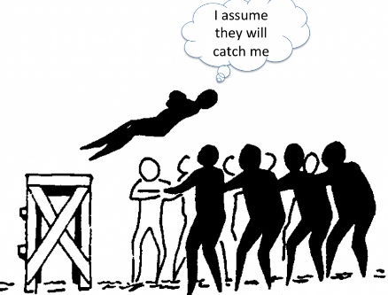
Assumptions? Constraints?
Read this description so that you are clear about the difference between ASSUMPTIONS and CONSTRAINTS: http://pmstudycircle.com/2012/10/assumptions-and-constraints-in-project-management/
Examples of assumptions for a construction project:
Heavy construction equipment will be available
The weather will be favourable
We will be able to obtain construction permits in a timely manner (without delays)
Examples of constraints for a construction project:
Project must be completed before a specified date
Workers cannot work during the night or while it’s raining
The project cannot exceed the $2 million budget
We must use unionized construction workers
Notes:
Assumptions – what I know, what I think I know, and what I don’t know
Image: https://www.google.ca/url?sa=i&rct=j&q=&esrc=s&source=images&cd=&cad=rja&uact=8&ved=2ahUKEwjx7Ludtv3dAhWU8oMKHb1xCF4QjRx6BAgBEAU&url=https%3A%2F%2Fwww.samatters.com%2Fassumptions-can-be-a-situational-awareness-barrier%2F&psig=AOvVaw2hkNsNFJXa2GIY1b3-3fw3&ust=1539314107259106

Slide 19

Assumptions AND Constraints
Video: Freelance advice: the importance of clarifying assumptions
Video: Understanding Project Assumptions and Constraints - Videocast
Notes:
Image: https://st3.depositphotos.com/1000765/19034/i/450/depositphotos_190347860-stock-photo-3d-small-people-constraints.jpg

